Slide 1
PREDICTING THE CHANCE OF GRADUATE ADMISSION FOR INDIAN STUDENTS
Maryam Runiassy
Pragna Yata

Slide 2
Objective: To choose best ways to model and predict the chance of getting admitted to a graduate school for students from India
Data source: Kaggle
Notes:
Can we predict the chance of getting amitted to a graduae school for students from India

Slide 3
Project Overview
Studying and comparing two datasets provided by Kaggle
Descriptive data analysis and visualizations
Modeling and training data with Regression Algorithms
Modeling data using Ensemble Algorithms
Cross Validation and Fine Tuning hyperparameters
Treating as a Classification problem

Slide 4
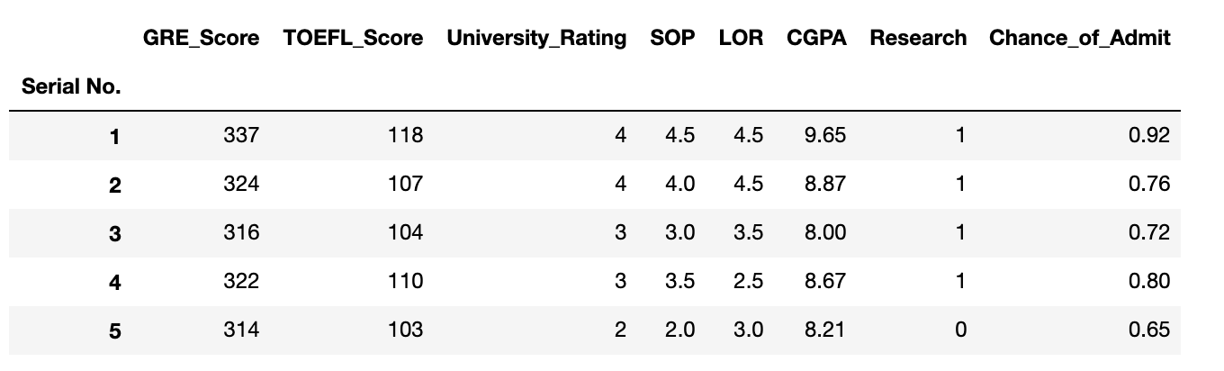
Dataset

Slide 5
Data Visualization
Tools used : Seaborn, pairplot and heatmaps
Objective
Checking data quality and search for extreme outliers
To note data distribution if it suitable for linear regression analysis.
Existing correlations
Outcome:
No missing values are in the data
Data is a combination of categorical and numeric variables
Data seems to be normally distributed
GRE_Score CGPA, and TOEFL_Score have the highest correlation with the chance of being admitted to a graduate school
Notes:
Why?/Objective
Checking the overall data quality and see if there are any extreme outliers.
See if the data is normally distributed and is suitable for linear regression analysis.
Checking possible existing correlations among independent variables as well as between independent variables and the dependednt variable.
To create visuals we used Seaborn as it is so easy to use and provides nice visualizations.
Inference:
No missing values are in the data; therefore we do not have to impute the for missing values.
Data is a combination of categorical and numeric variables.
Categorical variables are LOR, SOP, University_Rating, and Research. All of these fields are ordinal.
Numeric variables are GRE_Score, TOEFL_Score, CGPA, and Chance_of_Admit.
Chance_of_Admit is the dependent variable and numeric.
Data seems to be normally distributed.

Slide 6
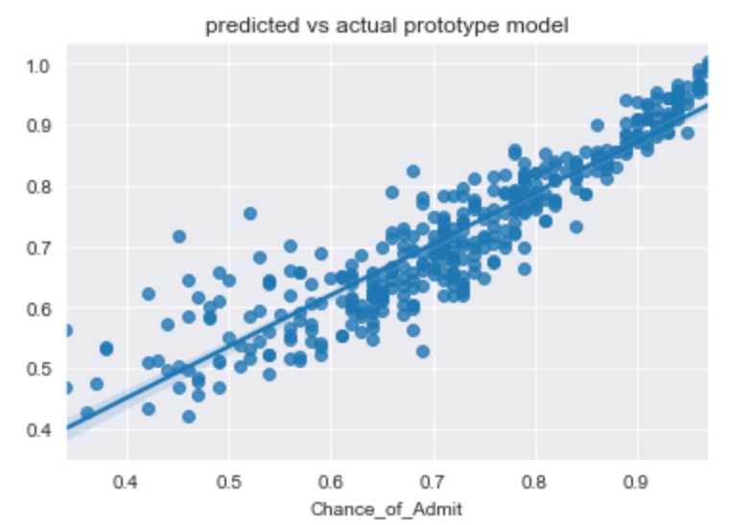
Regression Models
Models
Linear Models
Linear Regression
Tree Models
Decision tree
Ensemble Models
Random Forest
Catboost
XGboost
Neural Networks
KFold Cross Validation
Hyperparameter Search
Approach_1

Slide 7
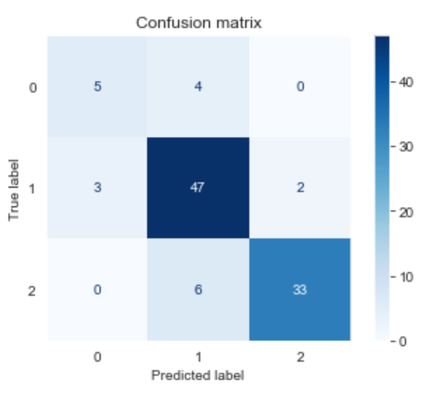
Classifiers
Approach_2
Multi-class
Two classes
Three classes
Logistic Regression
Random Forest
Stratified K-Fold Validation

Slide 8

Let's look at the code…...

